Slide 1
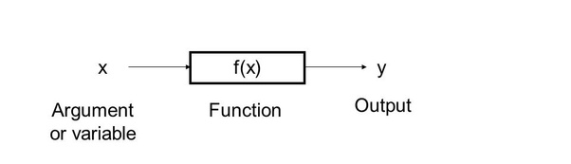
WHAT ARE FUNCTIONS?
Section of a program that performs a specific task
for e.g. covert number to binary 7 -> -> 111, print a string, maximum of a list, etc.
DEC to BIN

Slide 2
WHAT ARE FUNCTIONS?
Solution to given programming problem can be thought of in terms of functions needed. Functional Programing.
A library has collection of related functions. e.g. Math library has Mathematical functions.

Slide 3
Functions in Python
def functionname( parameters ):
"function_docstring"
function_suite
return [expression]

Slide 4
Built-in Functions
abs()
all()
any()
print()
id()
type()

Slide 5
Argument passing
Required arguments
def printme( str ):
"This prints a passed string into this function"
print (str)
return
printme(“My String”)
Keyword arguments
def printme( str ):
"This prints a passed string into this function"
print (str)
return
printme( str = "My string")

Slide 6
Argument passing
Default arguments
def printinfo( name, age=“35” ):
"This prints a passed info into this function"
print ("Name: ", name)
print ("Age ", age)
return
printinfo( name = "miki” )

Slide 7
Argument passing
Variable arguments
def printinfo( arg1, *vartuple ):
"This prints a variable passed arguments"
print ("Output is: ")
print (arg1)
for var in vartuple:
print (var)
return
# Now you can call printinfo function
printinfo( 10 )
printinfo( 70, 60, 50 )

Slide 8
Use Cases
(n,k) -> -> C(n,k)
e.g. (4,2) -> -> 6
(point1,point2,point3) -> -> area by heron’s
e.g. ((0,0),(3,0),(2,4)) -> -> 6
COMBINATORIAL
AREA OF TRIANGLE

